Slide 1
SUDAN AND CLIMATE CHANGE
Muhammad Zain Asad

Slide 2
INTRODUCTION
Sudan is located in the northeastern side of Africa and its area is about 2.5 million square kilometers
Sudan comes from the Arabic phrase bilād al-Sūdān, "land of the blacks.
The population in the range 35-40 million
The country is entirely depends on agriculture (rain-fed and irrigated farming).
A vulnerable country in the context of climate change – witnessed cycles of drought and floods

Slide 3
Land Mass Ratio
At about 3 times the size of Texas, Sudan is the 3rd largest country in Africa by land mass after Algeria and the Democratic Republic of the Congo, and the 16th largest in the world. Before the secession of South Sudan in 2011, Sudan was the largest country in Africa and the 10th largest in the world

Slide 4
IMPORT AND EXPORT
Sudan produces 80% of the world's gum Arabic supply, a binding substance found in gum, shampoo, soft drinks, marshmallows, and many other common products

Slide 5
IMPORT AND EXPORT
Over 97% of Sudan’s population is Muslim

Slide 6
Constitutions of the Republic of Sudan 2005
With respect to the protection of the environment chapter 2 article 11 of the Interim National Constitutions of the Republic of the Sudan States:
  The people of the Sudan shall have the right to clean and diverse environment; the State and the citizen have the duty to preserve and promote the country’s Biodiversity.
  The State shall not purse any policy, or permit any action which may adversely affect the existence of any species of animal or vegetative life, their natural or adopted habitat.
  The State shall promote, through legislation, sustainable utilization of natural resources and best practices with respect to their management

Slide 7
SUDANESE CLIMATE ZONES
The climate zones as shown in fig.:
vary from desert type in the north to semi desert in in north central parts of the country
In the central parts semi-arid through arid to dry sub-humid
Humid in the south

Slide 8
SUDAN CLIMATE ZONES FOR THE PERIOD 1971-2000
22.00
WHF
HAL
20.00
ARB
DNG
ABH
PSD
DESERT
KRM
TKR
18.00
AQQ
ATB
HDB
SHN
16.00
SHM
ARM
KHA
HLG
KSL
SEMI-DESERT
HAS
SHW
DUM
WMD
GDF
14.00
GEN
FSH
BAR
SNR
KHW
OBD
KST
UMB
NHD
ABN
12.00
NYL
DRY
RSH
RNK
DMZ
BNS
KDG
SEMI-DRY
KUR
10.00
MLK
RAG
SUB-HUMID
NSR
8.00
WAU
PIB
6.00
HUMID
MAR
JUB
KAP
YAM
8.00
TOR
NAG
4.00
22.00
24.00
26.00
28.00
30.00
32.00
34.00
36.00
38.00

Slide 9
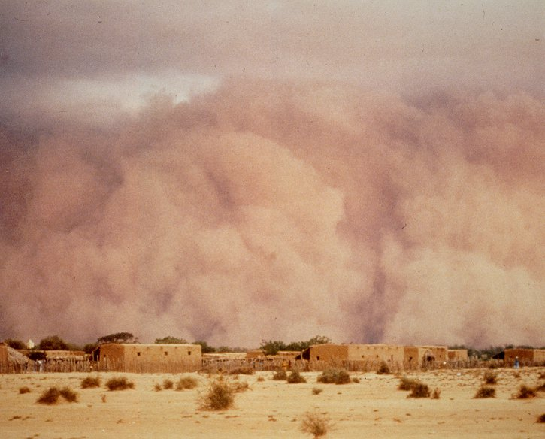
Dust-storm

Slide 10
Climate Change in Sudan
Vulnerability & Adaptation – Rationale in Sudan:
There is an ample evidence that climate has reported a clear change in the climate during the last three decades of the twentieth century.
Sudan is particularly concerned with impacts of climate change:

Slide 11
The majority of its land is quite sensitive to changes in temperature and precipitation
Fragile ecosystem
Weak infrastructure and economy
Food security is mainly determined by rainfall
More than 70% of Sudan population is directly dependent on climate-sensitive resources for their livelihood.

